Slide 1
Chapter 2. Network Models
Layered Tasks
The OSI Model
Layers in the OSI Model
TCP/IP Protocol Suite
Addressing
2-<number>

Slide 2
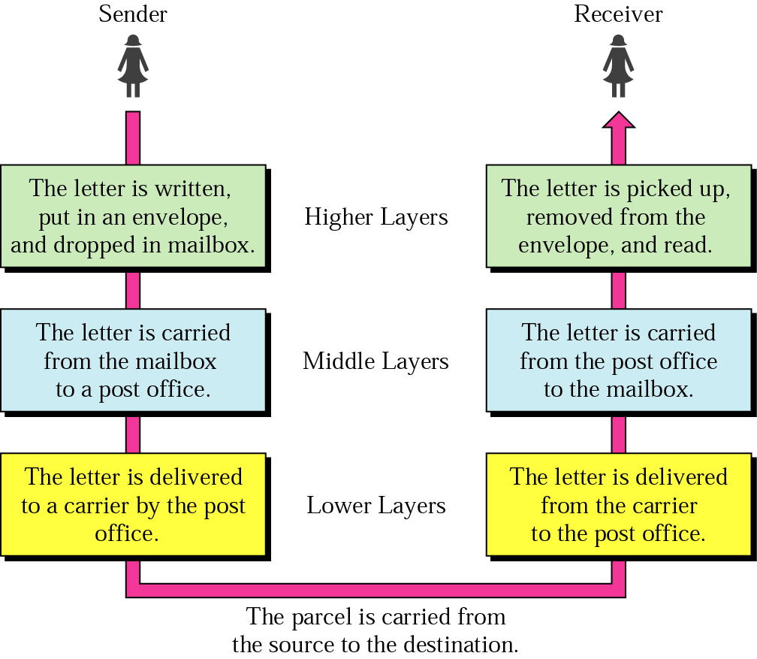
Layered Model: Sending a Letter
2-<number>

Slide 3

OSI Model
ISO is the organization. OSI is the model
2-<number>

Slide 4

Interaction between layers in the OSI model
Layer and interface
2-<number>

Slide 5

An exchange using the OSI model
Encapsulation with header and possibly trailer
2-<number>

Slide 6


Physical Layer
The physical layer is responsible for movements of individual bits from one hop (node) to the next
Mechanical and electrical specification, the procedures and functions
2-<number>

Slide 7

Physical Layer: Duties
Physical characteristics of interfaces and medium
Representation of bits
  Encoded into signals – electrical or optical
Data rate
Synchronization of bits
Line configuration
Physical topology
Transmission mode
2-<number>

Slide 8

Data Link Layer
The data link layer is responsible for moving frames from one hop (node) to the next
Transform the physical layer to a reliable (error-free) link
2-<number>

Slide 9

Data Link Layer: Duties
Framing
Physical addressing
Flow control
Error control
Access control
2-<number>

Slide 10

Hop-to-Hop Delivery
2-<number>

Slide 11

Network Layer
The network layer is responsible for the delivery of packets from the source host to the destination host
2-<number>

Slide 12

Network Layer: Duties
Logical addressing and routing
2-<number>

Slide 13
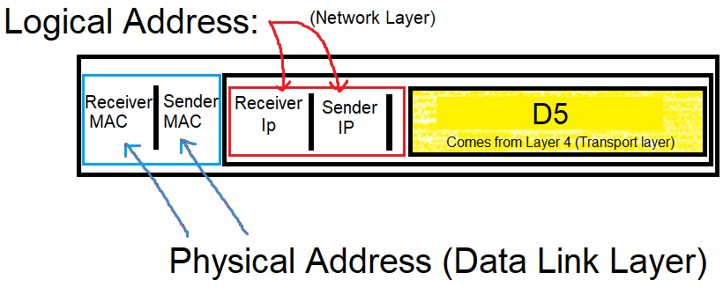
Network Layer: Duties
Data Communications, Kwangwoon University
2-<number>

Slide 14
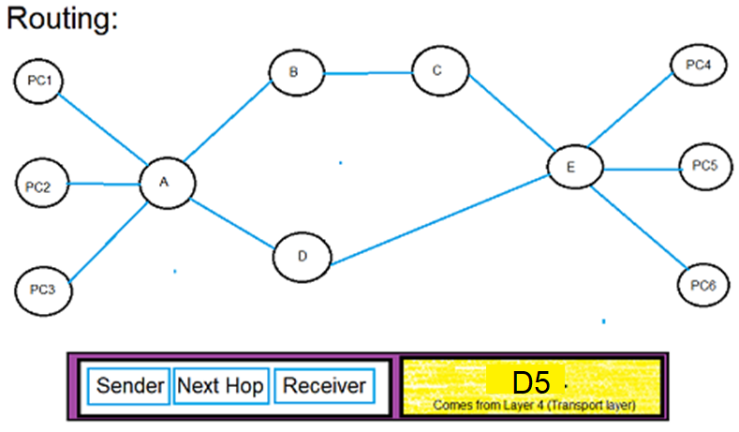
Network Layer: Duties
Data Communications, Kwangwoon University
2-<number>

Slide 15

Transport Layer
The transport layer is responsible for delivery of a message from one process to another
2-<number>

Slide 16

Reliable Process-to-Process Delivery of a Message
2-<number>

Slide 17
Transport Layer: Duties
Service-point (port) addressing = 16 bit = 10101100 10101100
Segmentation and reassembly
Connection control
Flow control
Error control
2-<number>

Slide 18
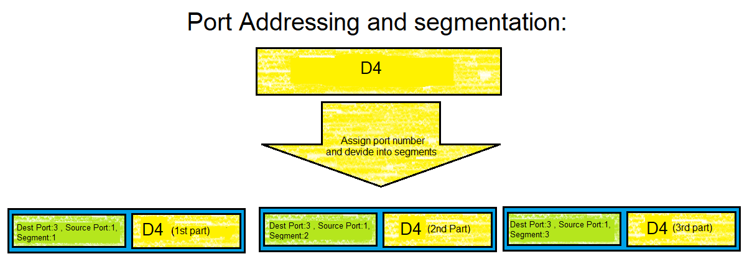
Transport Layer: Duties
Data Communications, Kwangwoon University
2-<number>

Slide 19
Transport Layer: Duties
Connection control :
Connection less → UDP protocol
Connection oriented → TCP protocol
Data Communications, Kwangwoon University
2-<number>

Slide 20

Session Layer
Session layer is responsible for dialog control and synchronization
2-<number>

Slide 21
Session Layer: Duties
Authentication
Authorization
Synchronization
Data Communications, Kwangwoon University
2-<number>

Slide 22

Presentation Layer
Presentation layer is responsible for translation, compression, and encryption
2-<number>

Slide 23
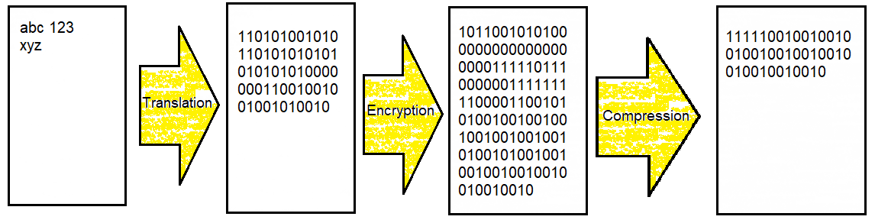
Presentation Layer : Duties
Data Communications, Kwangwoon University
2-<number>

Slide 24

Application Layer
Application layer is responsible for providing services to the user
2-<number>

Slide 25
Application Layer: Services
Network virtual terminal
Mail services
File transfer, access, and management
Directory services
2-<number>

Slide 26

Summary of Layers
2-<number>

Slide 27
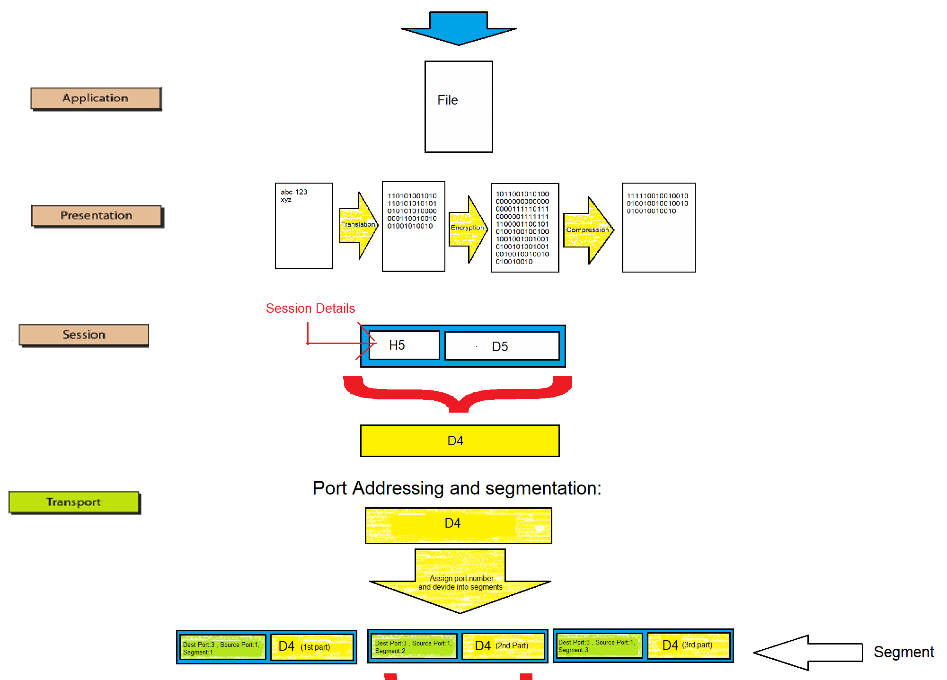

Data Communications, Kwangwoon University
2-<number>

Slide 28
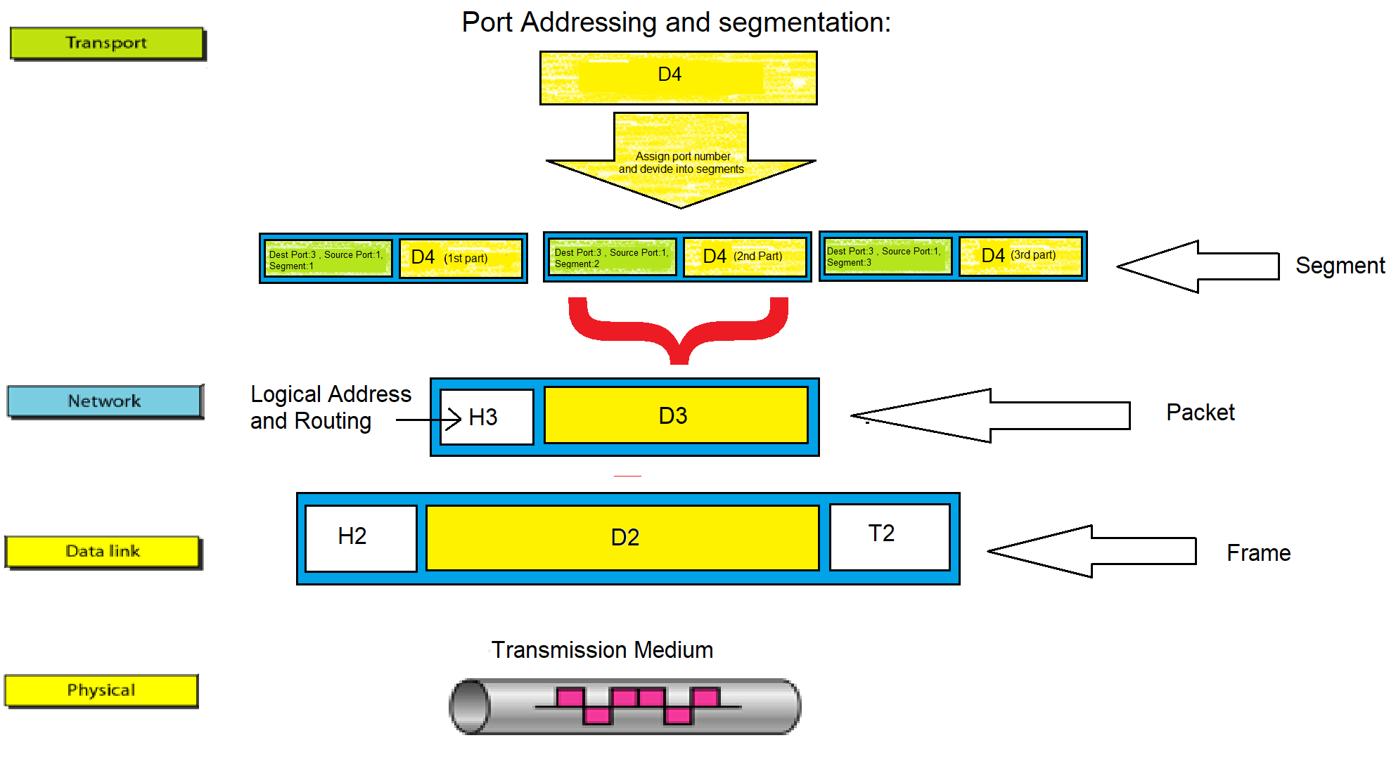
Data Communications, Kwangwoon University
2-<number>

Slide 29

TCP/IP and OSI Model
2-<number>

Slide 30
TCP/IP Protocol Suite
Host-to-network : Physical and data link layer
  No specific protocol
Network layer
  IP(Internet Protocl), ARP(Address Resolution Protocol), RARP(Reverse ARP), ICMP(Internet Control Message Protocol), IGMP(Internet Group Message Protocol)
Transport layer
  TCP(Transmission Control Protocol), UDP(User Datagram Protocl), SCTP(Stream Control Transmission Protocol),
Application Layer
  Combined session, presentation, and application layers
2-<number>

Slide 31
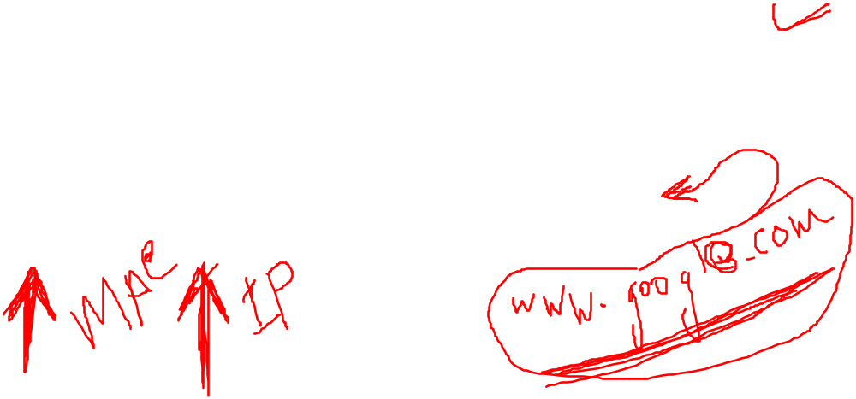

Addressing
Four levels of addresses in TCP/IP protocols
Physical (link), logical (IP, network), port, and specific addresses
2-<number>

Slide 32

Relationship of Layers and Addresses
2-<number>

Slide 33

Physical Address
A node with physical address 10 sends a frame to a node with physical address 87. The two nodes are connected by a link (bus topology LAN). As the figure shows, the computer with physical address 10 is the sender, and the computer with physical address 87 is the receiver.
07:01:02:01:2C:4B
A 6-byte (12 hexadecimal digits) physical address.
2-<number>

Slide 34

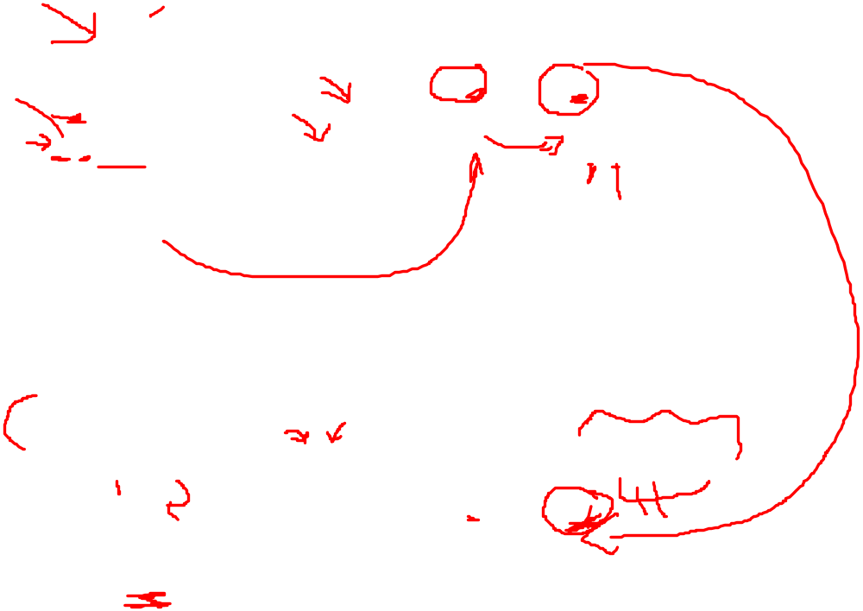
Logical (IP) Address
The physical addresses will change from hop to hop, but the logical addresses usually remain the same
2-<number>

Slide 35

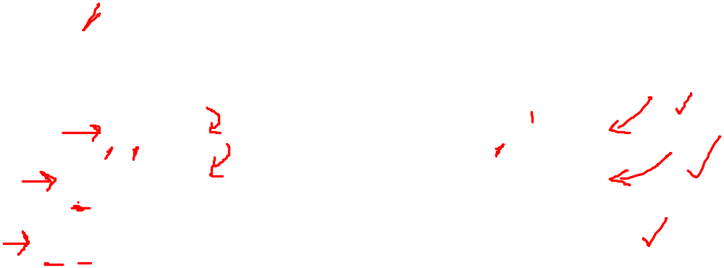
Port Address
The physical addresses change from hop to hop, but the logical and port addresses usually remain the same
2-<number>

Slide 36
Specific Address
Some application have user-friendly addresses that are designed for that specific address
Example 1: e-mail address: md.nahiyan@uap-bd.edu
  Defines the recipient of an e-mail
Example 2: URL (Universal Resource Locator) : www.uap-bd.edu
  Used to find a document on the WWW
2-<number>

Slide 37

Home Works
Page 53
  Problems: 16 - 19
Page 54
  Problems: 20, 21, 23, 24, 25, 26, 27, 28

